Slide 1
Project Presentation
The AI with Monte Carlo Tree Search
Zhenze Zhao-C00198551

Slide 2
Introduction
I want to have a AI that will able to complete a GO game precisely and efficiently
The Go game is developed using Unity 3D, and the AI is coded by using C#.
The Monte Carlo Tree Search algorithm is a good choice for a game with a large number of possibilities.
In the end, I compare the Monte Carlo Tree Search AI with AlphaBeta(Minimax) AI to learn the differences between 2 AI.

Slide 3
The Go game
2D grid of tiles
The official board is 19 *19, but the one used here is smaller like 5*5, 7*7 and 9*9.
Each player needs to take turns to acquire/take as many tiles from the board as that can by placing game pieces.
The player can take off opponent’s pieces by surrounding his/her pieces with their own pieces.

Slide 4
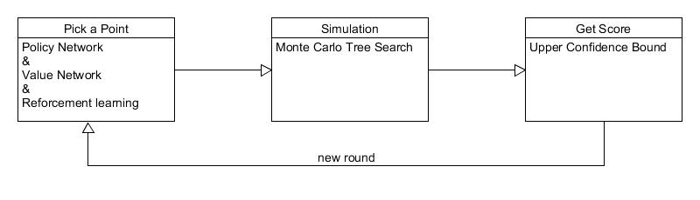
The AI for Go game
The steps for AI:

Slide 5
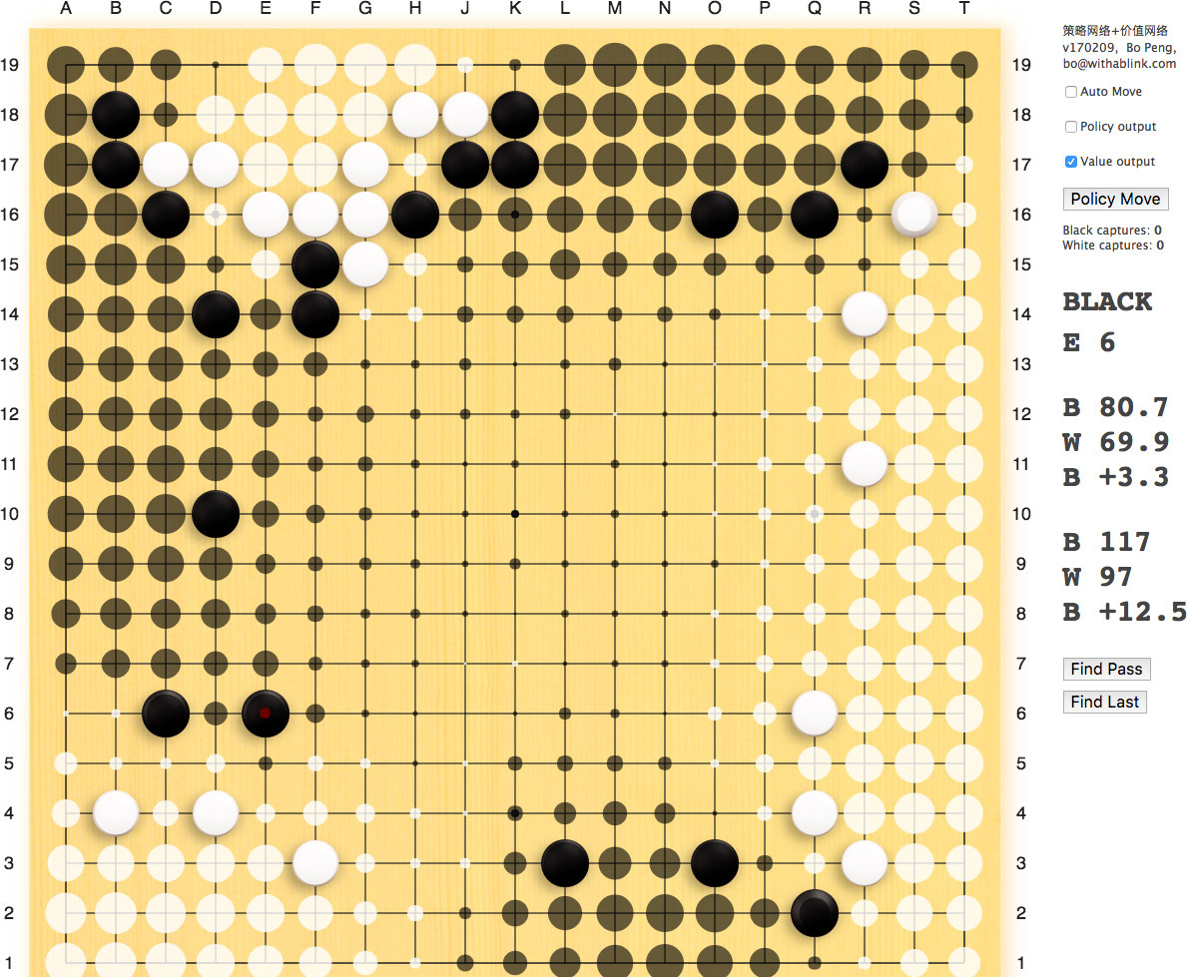
Policy Network and Value Network
The network help AI to make a decision
The Policy Network shows the win- rate for every point on the board
The Value Network shows the win rate of the current state.

Slide 6
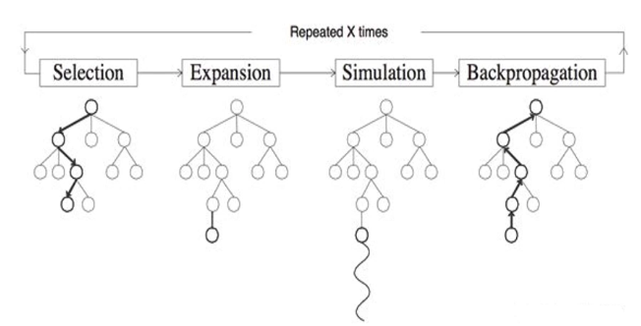
Monte Carlo Tree Search(MCTS)
The MCTS is based on the 4 steps blow:
Selection
Expansion
Simulation
Backpropagation

Slide 7
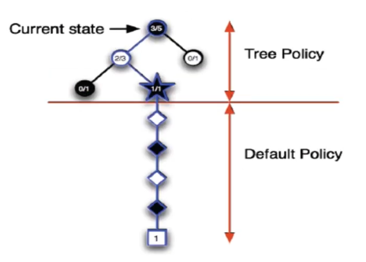
Monte Carlo Tree Search(MCTS)
And these 4 steps can be summarized as 2 policies.
Tree Policy: Select or create a leaf node from search tree.(step 1.)
Default Policy: Simulate the game to the end by starting from an unknown node.(step 2,3,4. )

Slide 8
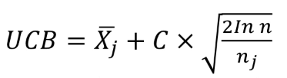
Upper Confidence Bound(UCB)
The UCB algorithm is looking for the best node between exploitation and exploration.
Exploitation: Makes sure the past decisions have the most advantageous paths/results.
Exploration: Looks for more advantageous paths/results from future decision.
Xj is the average score for current node, nj is the number of times visited current node, n is the overall number of all simulation.

Slide 9
Demo Video
Two different AI in the same game
https://drive.google.com/file/d/1wQiZFXWbmyLT6Xu8AJwG1U2padl-7SyT/view?usp=sharing

Slide 10
Results
In the game with 5 * 5 board size and 3 depth, the AlphaBeta Algorithm can get the answer faster . But when the board size and exploration depth increased, the AlphaBeta will take more time to find the answer.
The MCTS AI is a little bit slower in 5 * 5 board size. When the board size gets larger, the AI’s thinking time will increase, however，the MCTS AI will be faster than the AlphaBeta AI after the size increase.

Slide 11
Conclusions
The AlphaBeta algorithm is a good choice for “limited possibilities”, because this algorithm needs all possibilities data. The Monte Carlo Tree Search is different, the network algorithms help the AI to skip the unnecessary or low value possibilities, thus reducing simulation/thinking time.
The Monte Carlo Tree Search is just a random search, it needs the other algorithms to help the AI make decision or find the best selection.

Slide 12
Questions?
Thanks for Listening

